Slide 1
All slides & white paper are posted online
Case use for sUAV (small Unmanned Aerial Vehicle) for large dam spillway monitoring, data sets and inspections
Session 4H
Dave McCreary – President, NewAgeAerial.com
Peter Wade P.E. - Hydroelectric Manager, Merced Irrigation District
Notes:
Thank you Mike for that introduction, I would like to introduce Peter Wade, PE of Merced Irrigation District. We are both based in Northern California. We invite you to engage with this presentation as it is currently posted online with additional information and videos completely open to all, so no need to capture with your cell phones. 30 seconds! NO death by Powerpoint

Slide 2
Drone use in the 2017 Spillway armoring project
Drones documenting & contributing to the 2017 spillway armoring project
New Exchequer Dam
Constructed between 1964 and 1967
Rockfilled dam
Gated Spillway
Emergency Spillway
95 MW power generator
Low Level outlet Valve (108” = 9,000 cfs)
New Exchequer Dam – Merced Irrigation District, Northern California
Constructed between 1964 and 1967 (Oroville was also completed in 1967)
rock filled dam | gated spillway | emergency spillway
95 MW power generator | Low Level outlet Valve (108” = 9,000 cfs)
All slides & white paper are posted online
Notes:
As drone usage continues to grow in many different facets, MID took a giant leap forward to become a leader in ground based aerial data modeling. 30 seconds

Slide 3
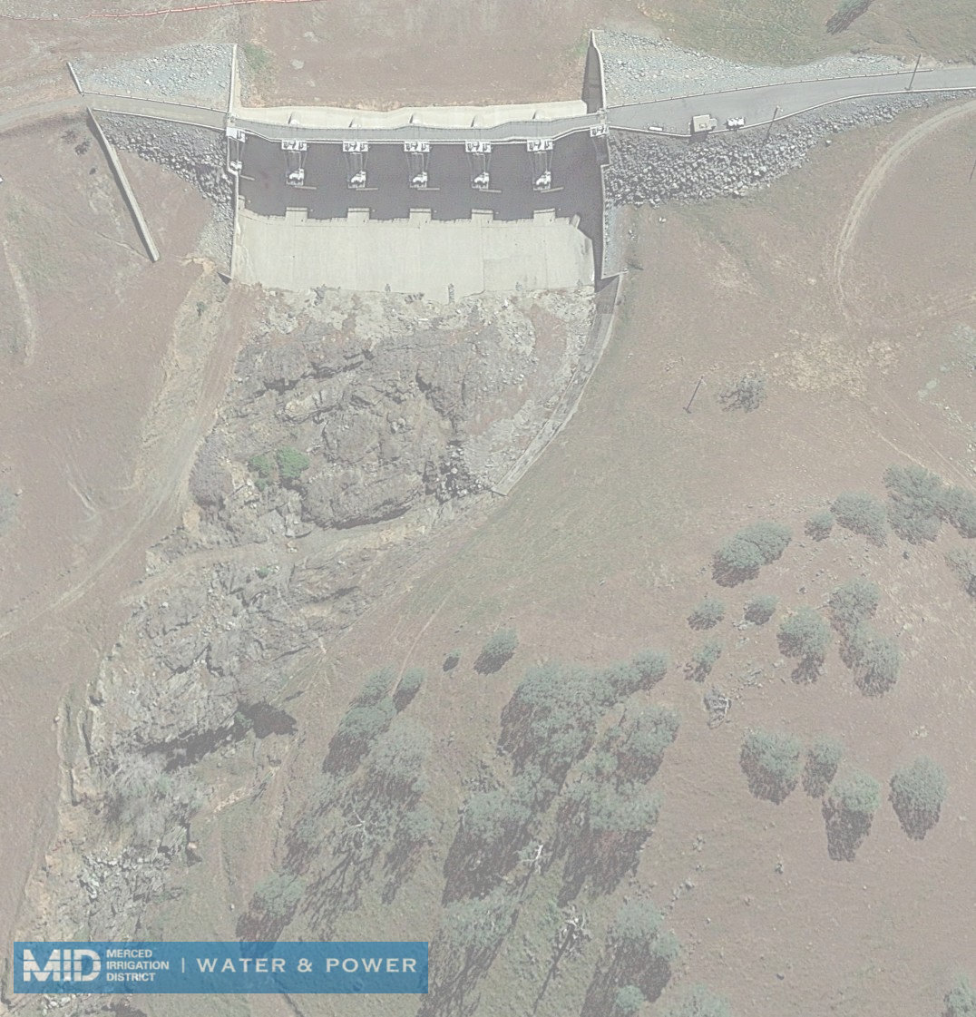
All slides & white paper are posted online
Gated spillway
& unlined
spillway channel
6 gates (40’wide x 30’ high)
apron and cutoff wall
once used spillway flows into 1.8 mile long unlined channel
Spillway first used in 1967 for 33 days and up to 10,000 cfs. 1967 unlined channel armored after use to repair damage
Notes:
Peter: existing conditions of the project. Remember ONE minute per slide

Slide 4
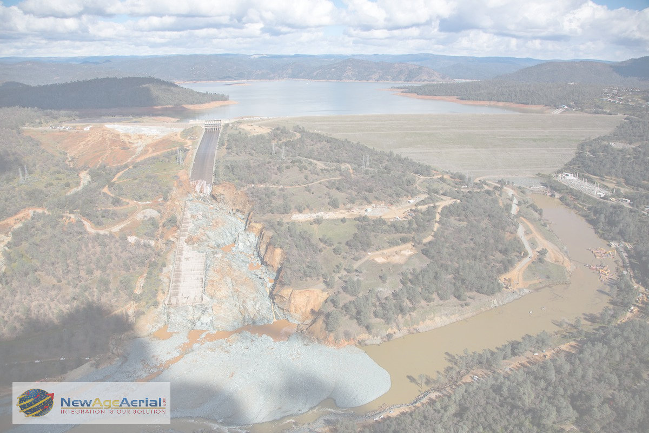
All slides & white paper are posted online
2017 we all watched events at Oroville spillway unfold in a perfect storm…
Notes:
Peter: We all logged in each morning as these events in February unfolded to see the latest. This image was taken from a Cessna outside of the TFR. NAA had to re hanger our planes as we fell along with appox. 200,000 others inside the evac zone

Slide 5
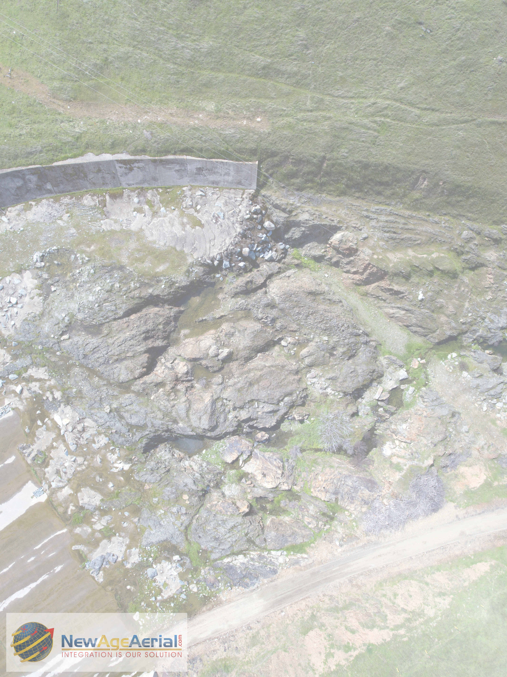
All slides & white paper are posted online
MID decided to add armoring
Below the apron and 1967 armoring
highly fractured, erodible geologic conditions, it was
decided to armor where the rock is softer than concrete.
Extending the armor for a reasonable distance downstream of existing apron and cutoff wall.
Notes:
Existing scouring conditions of Phase I

Slide 6
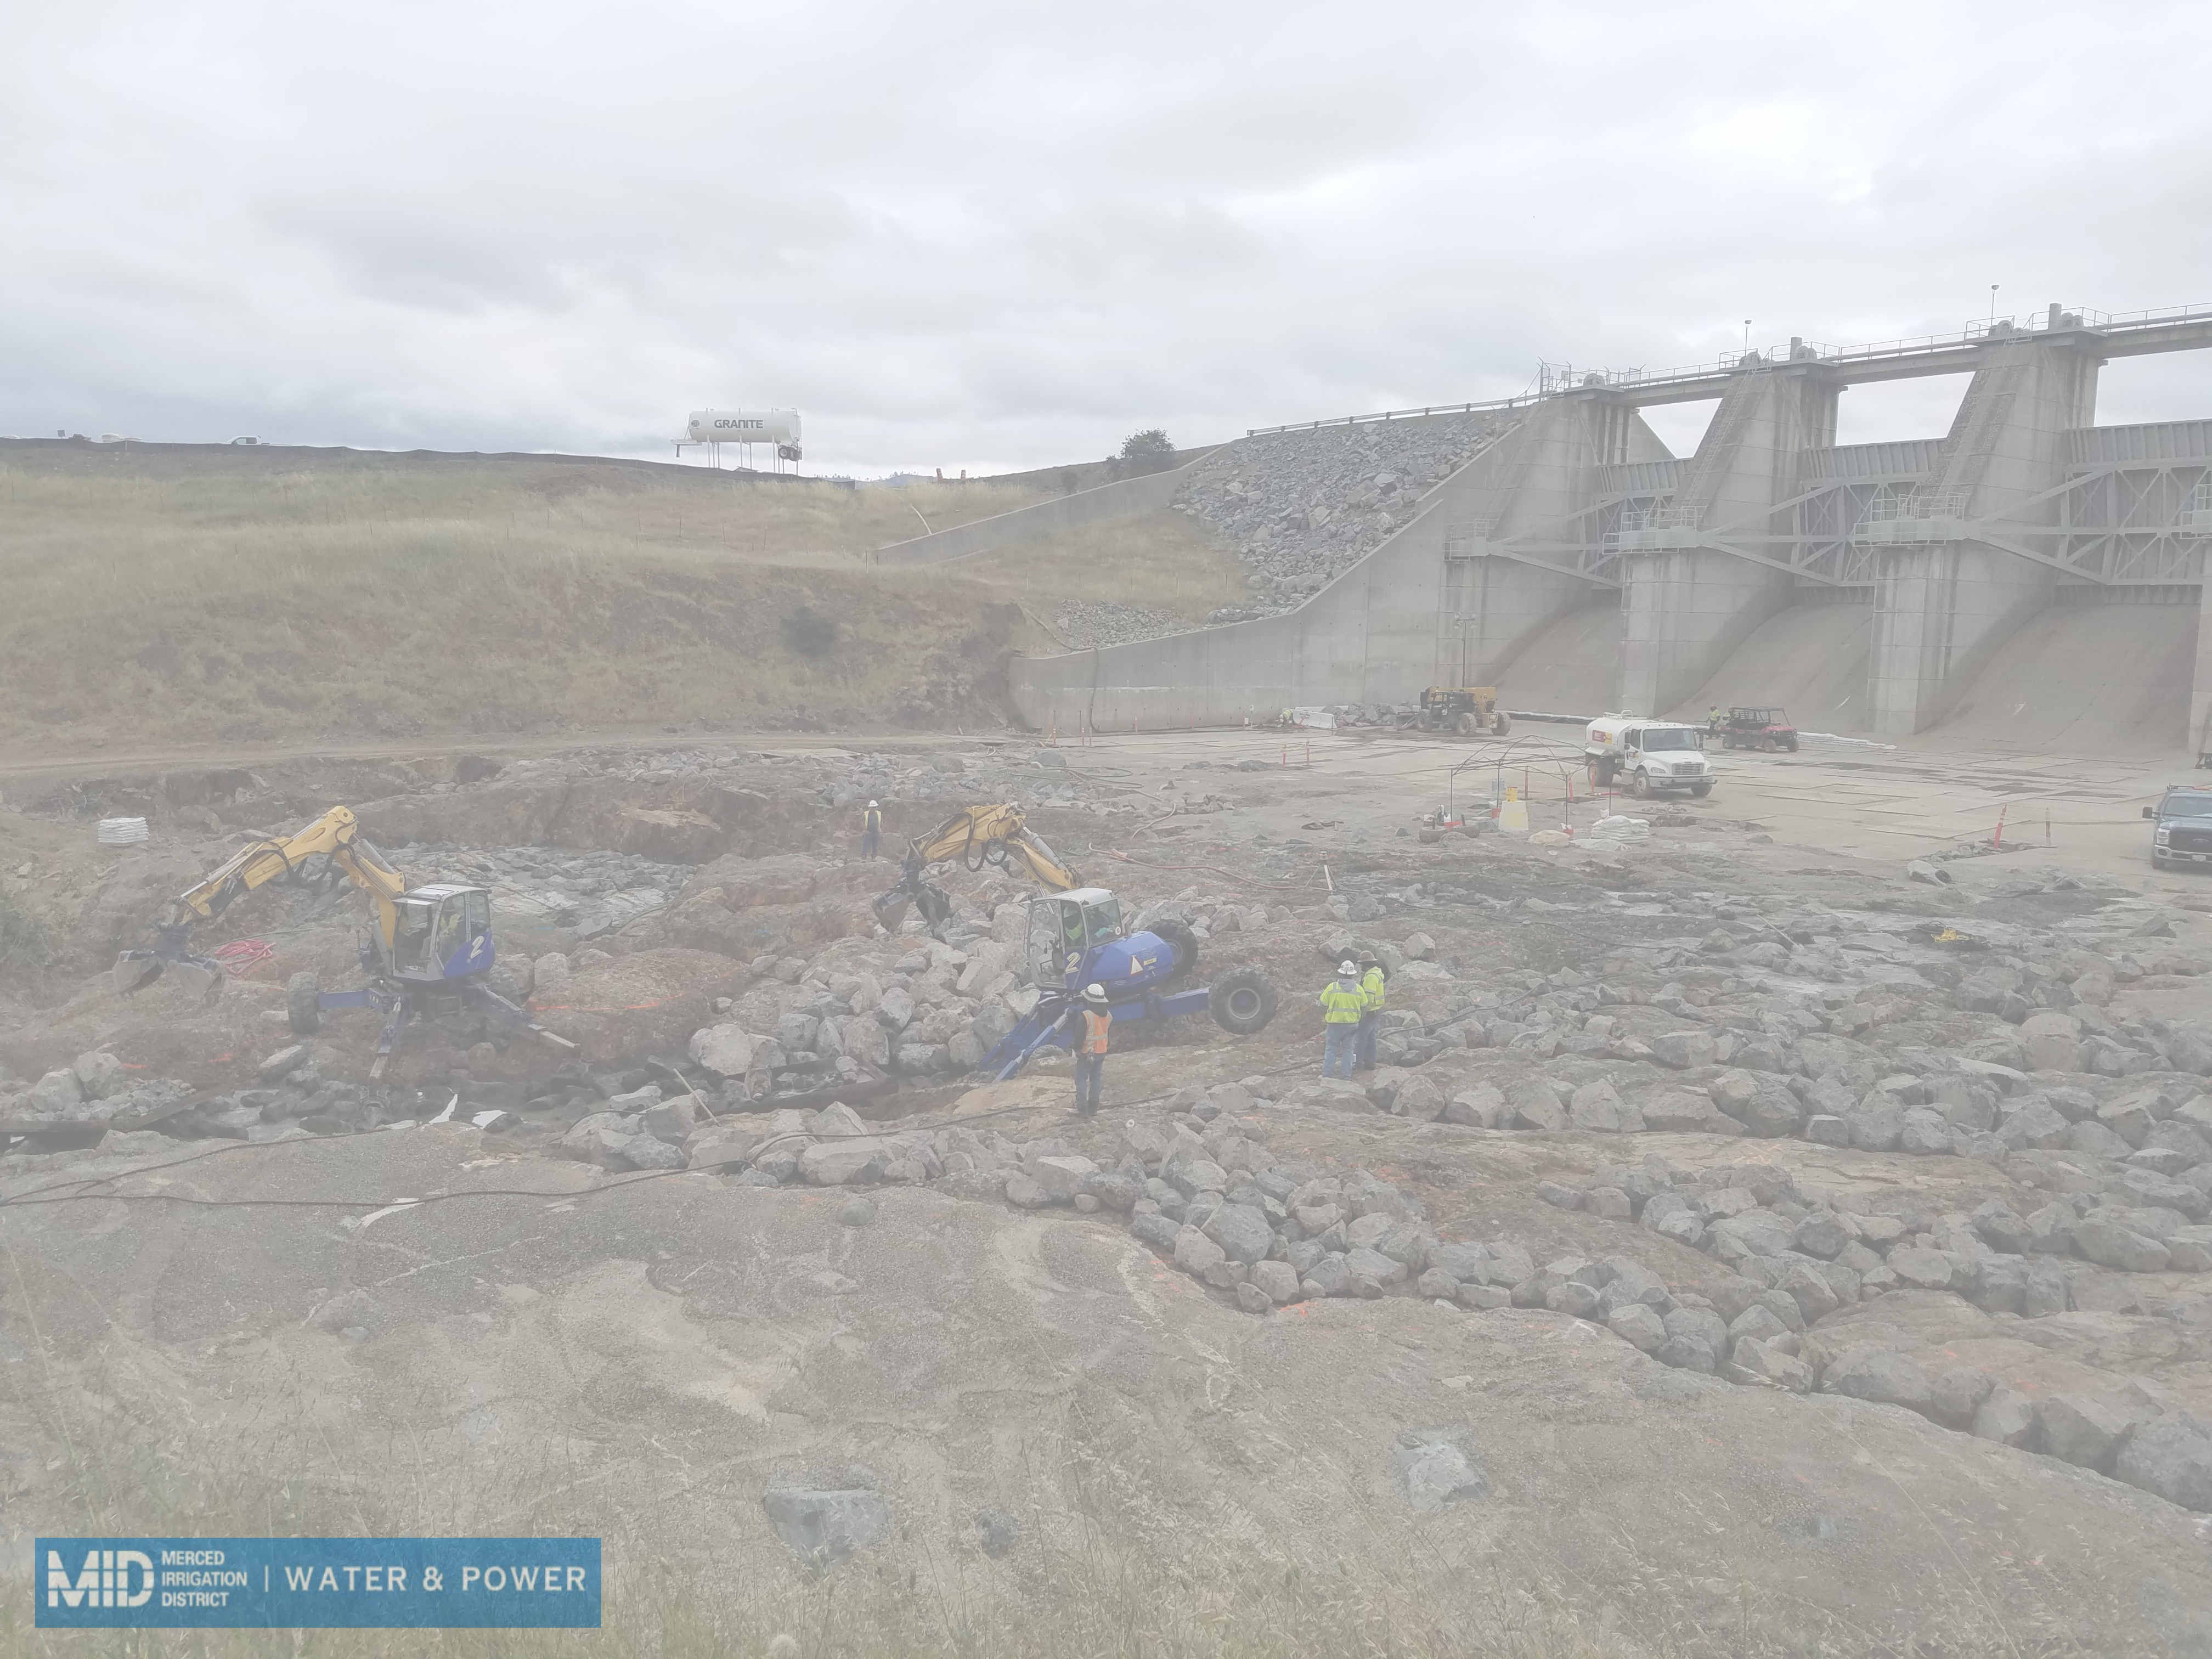
All slides & white paper are posted online
Removal of loose & undesired material
Mechanical scraping by use of 4 legged spider | Pressure washing | Removing loosened material | Vac trucks used in conjunction with 4 legged spider
Notes:
Work begins on Phase II – how many man hours / days / weeks

Slide 7
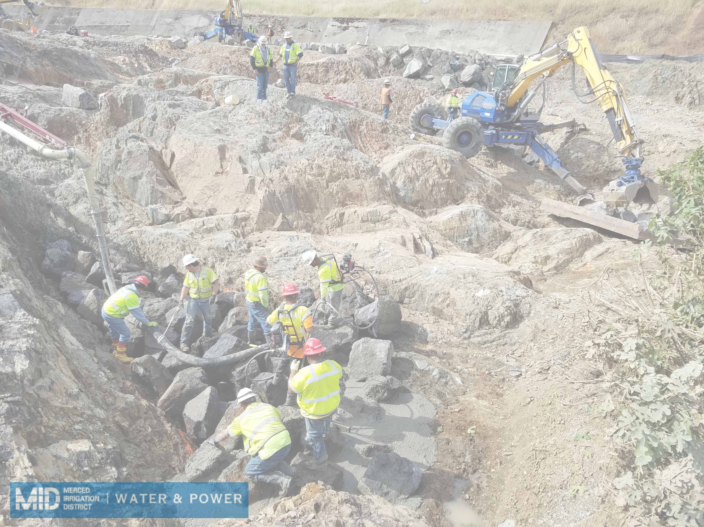
All slides & white paper are posted online
Bouldering & pumping concrete
Notes:
Construction process

Slide 8
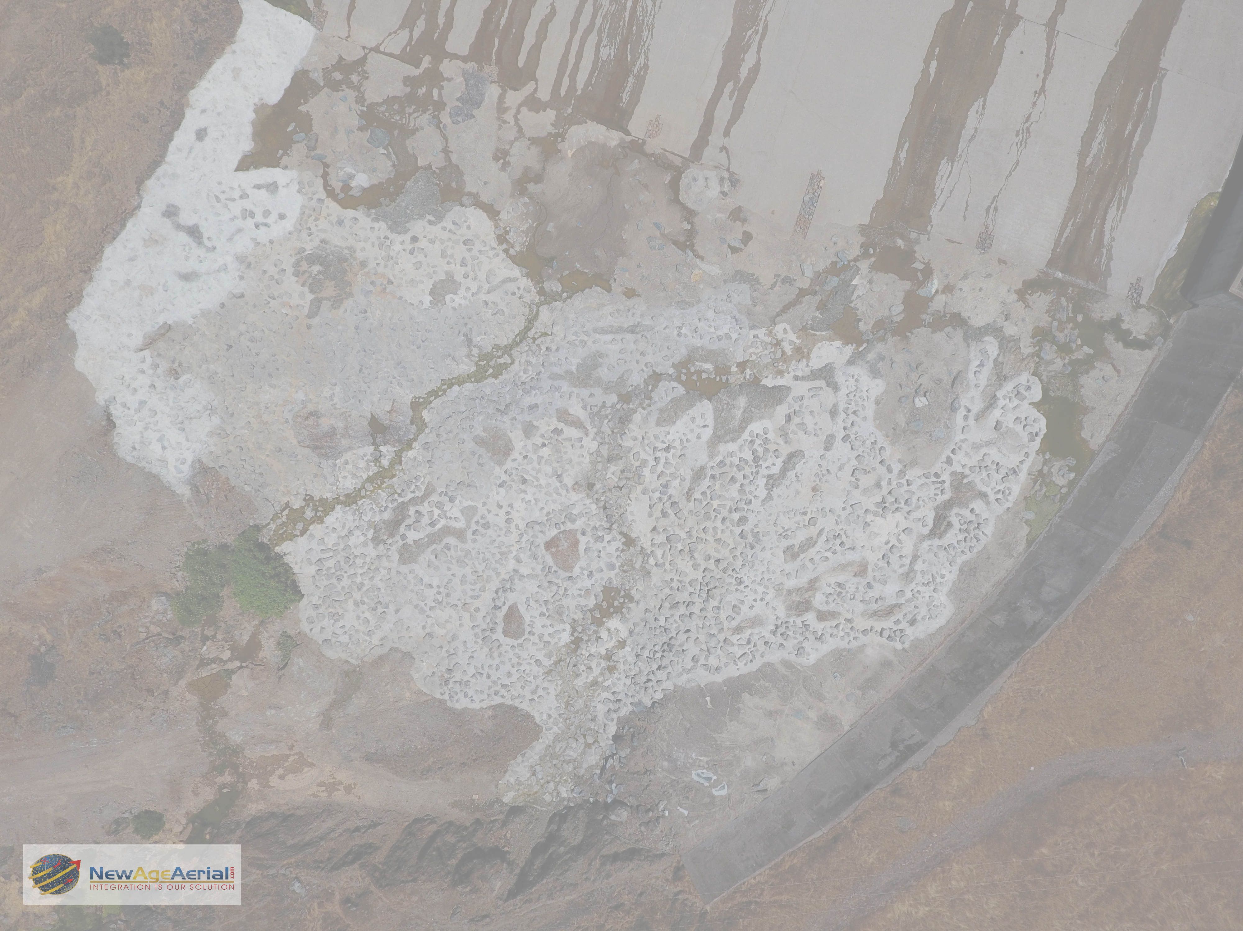
All slides & white paper are posted online
1967 repair
1967 repair
1967 repair
2017 Finished Product
1967 repair
Notes:
Final stats: cubic yards of….. Total tons of boulders…..

Slide 9
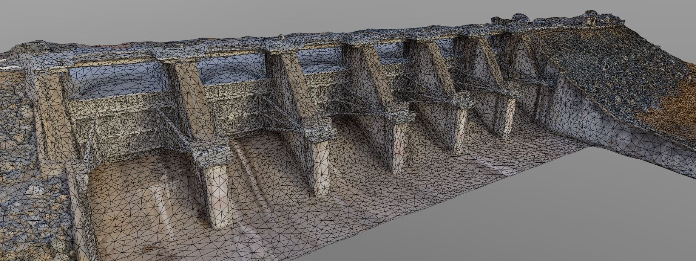
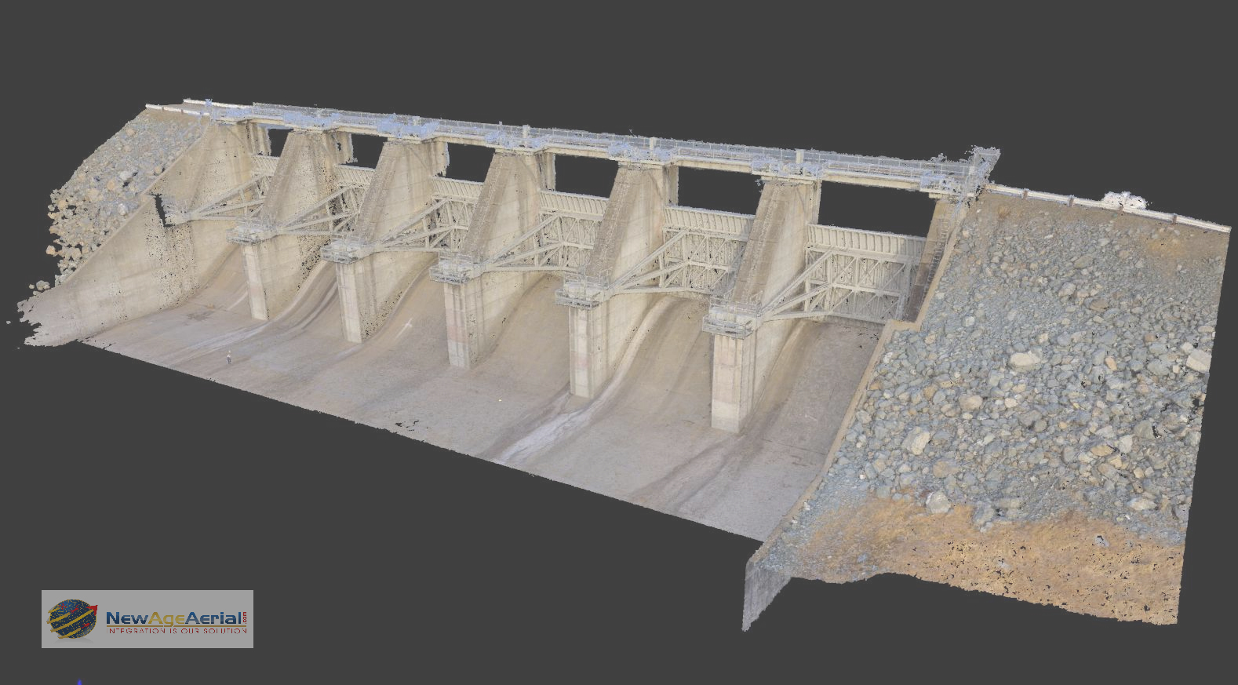
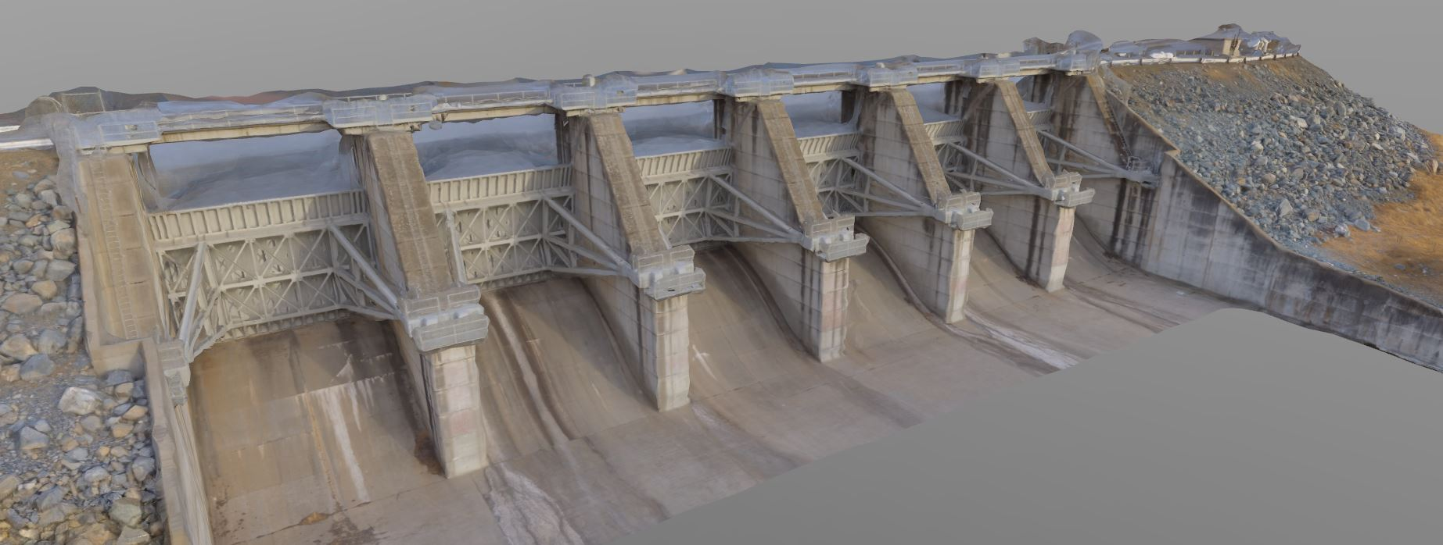
All slides & white paper are posted online
Point cloud & modeling of spillway
Point cloud ray trace
Point cloud mesh rendering
Very dense color point cloud
Sub 2cm accuracy for the entire spillway, 1.8 mile downstream channel and dam / powerhouse complex. +1TB of data collected
Notes:
Dave: Photogrammetry was used to model the spillway / downstream condition / emergency spillway / dam and powerhouse. All data is stored on a secure cloud server for the client and consultants use. Remember ONE minute per slide

Slide 10
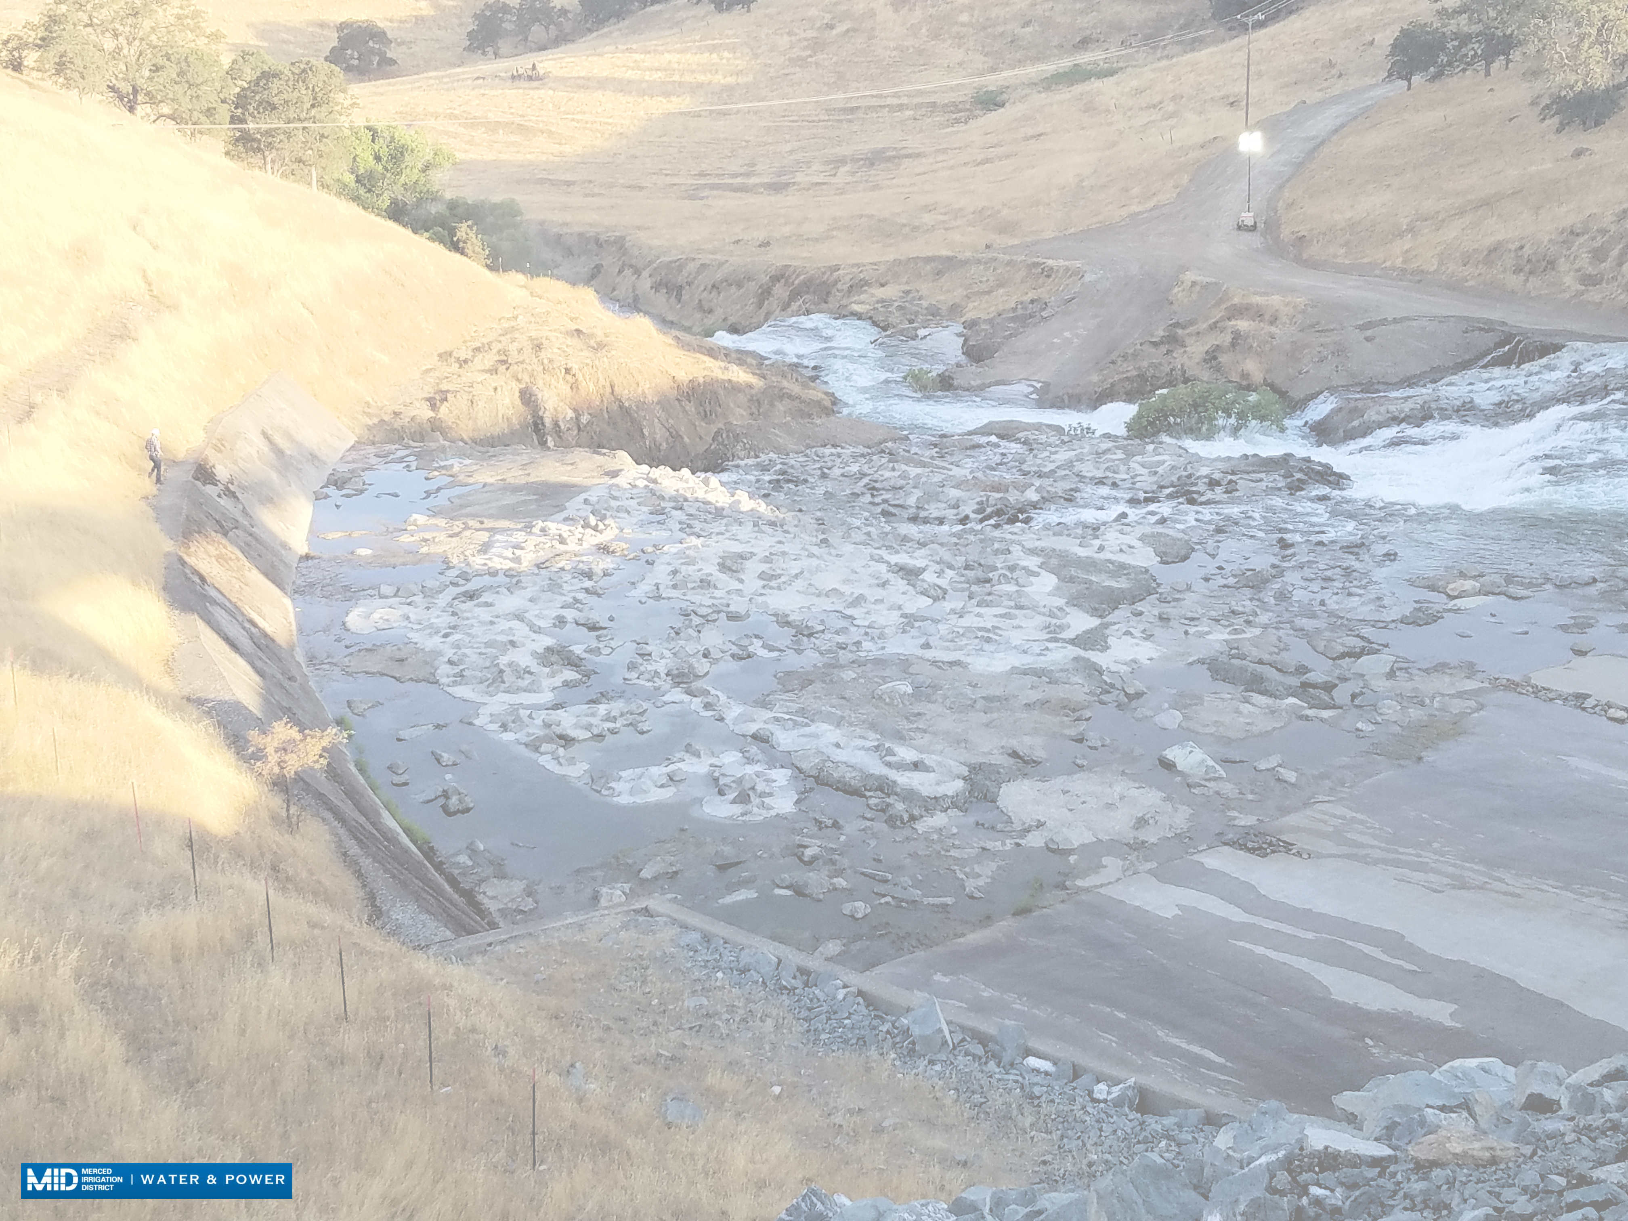
All slides & white paper are posted online
Flow testing in July (2nd time in use in 50 years)
4 days, with 18 hours of flow and 6 hours of inspections
Day 1 = 500 cfs
Day 2 = 1,000 cfs
Day 3 = 2,000 cfs
Day 4 = 3,000 cfs – real time drone videos of the gates opening and run offs for this test are posted on website, address on the last slide of this presentation
Material movement in un-lined spillway channel monitored
Notes:
Peter: talk about the process and initial findings

Slide 11
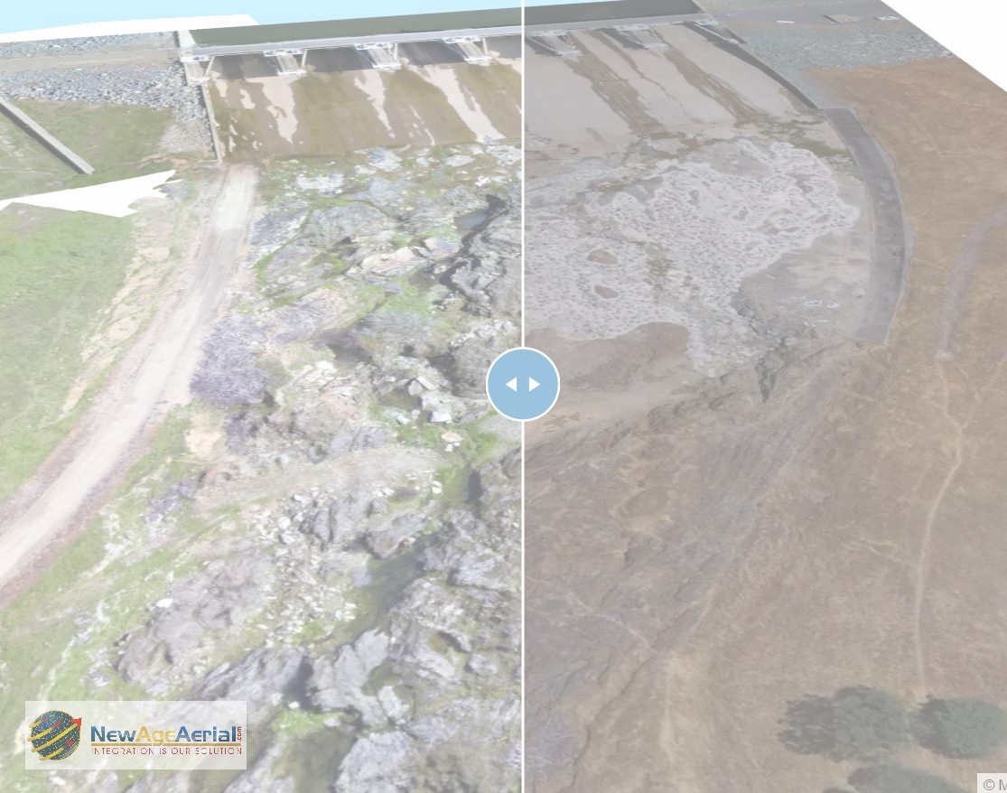
All slides & white paper are posted online
sUAV use and processing recap
Phase I: Before cleaning documentation
Phase II: After cleaning, before addition of new material
Phase III: After construction, prior to spill and after spill erosion analysis
Deliverables: Point clouds, 4k images and HD videos, 3D printed & painted scale models, interactive overlays showing phases I and III
“how do you monitor sub-centimeter change if you do not have a visual record of the ‘before’…”
NAA used Pix4D for: point | mesh | DTM | DSM | volumetrics | animation | elevation maps
GEI/HDR and other consultants where able to use same final dataset for their evaluation reports, that were submitted back to MID.
Notes:
Dave: as you can see on this slide we have the ability to have the Phase I and III side by side in real time. This data set was delivered in multiple formats for a variety of uses by multiple consultants

Slide 12
Slides, additional content & white paper available at: NewAgeAerial.com/Hydrovision2018
Q & A
Drone drawing!
HD camera | IR avoidance sensors | 13 min flight time iNTEL & DJI’s latest project!
Make sure your business card is in the jar, must be present to win. Drawing in the lobby right after we are dismissed, so the next session can get started on time!
Available on the floor for the rest of the day in this cool vest, I shouldn’t be hard to spot to answer any questions!
Notes:
On behalf of Peter Wade of MID we thank you for your questions and attendance. NOW you can take a picture of this slide to review this material online as you wish. Please make sure that your business card is in the bowl for the drawing of the High Def / smart phone controlled DRONE. We will meet in the lobby right outside the door. THANK YOU.

